Slide 1
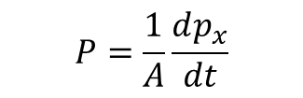
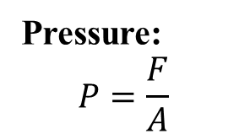
Measuring Pressure and Temperature
Measureable Macroscopic Quantities
Energy
No. of Particles, N
Volume, V
Pressure, P
Temperature, T
When an average (or mean) value becomes independent of time, we say equilibrium has been achieved.
Pressure:
$$P=\frac{F}{A}$$
$$P=\frac{1}{A}\frac{dp_{x}}{dt}$$
Scalar or Vector?
p_{x} = momentum perpendicular to the surface

Slide 2
Temperature
Temp and energy: Related but not the same.
How do we measure it?
Using Thermometer
Operational Definition
“Temperature is what we measure with thermometer”
Theoretical Definition
“something” that becomes equal when two objects have been in contact for long enough”.
What type of contact?
How long is long enough?
How do we actually ascribe numerical value to the temperature?
What if there are more than one quantities those end up being same for both objects in contact?
Thermal Equilibrium
Relaxation time
When two objects have been in contact long enough, we say they are in thermal equilibrium
The time required for a system to come to thermal equilibrium

Slide 3
Mostly principle of after relaxation time, the thermometer and the system of interest become in thermal equilibrium.
In this case “Contact” is a mean of exchanging “Heat”
Exchange of energy
For any equilibrium
Exchange of quantity
Type of equilibrium
Quantity Exchanged
Thermal
Energy
We know that energy flows from high temperature to lower temperature object
Mechanical
Volume
Diffusive
Particles
Restating Theoretical Definition
Temp is a measure of tendency of an object to spontaneously give up energy to its surrounding.
When two objects are in thermal contact, the one that tends to spontaneously lose energy is at higher temperature

Slide 4

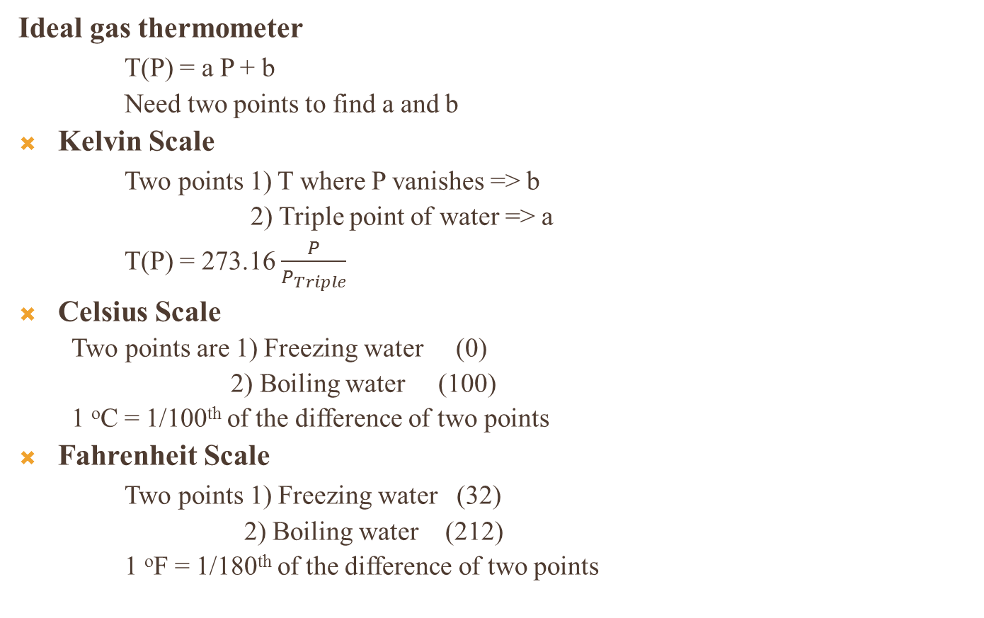
Thermometers
Ideal gas thermometer
T(P) = a P + b
Need two points to find a and b
Kelvin Scale
Two points 1) T where P vanishes => b
2) Triple point of water => a
T(P) = 273.16 $\frac{P}{P_{Triple}}$
Celsius Scale
  Two points are 1) Freezing water (0)
  2) Boiling water (100)
  1 ºC = 1/100th of the difference of two points
Fahrenheit Scale
Two points 1) Freezing water (32)
2) Boiling water (212)
1 ºF = 1/180th of the difference of two points
Mostly principle of
Thermal Expansion
Experimentally a = 273.15
T(ºC) = T(K) -273.15
$\frac{T(\text{o}\text{C}) }{100}$ = $\frac{T\left(\text{o}\text{F}\right)−32}{180}$

Slide 5


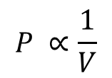




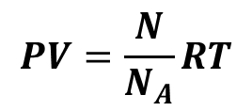

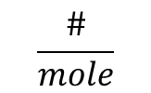


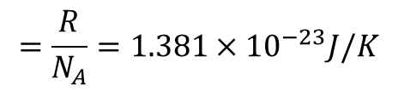
Ideal Gas
$$P ∝T$$
V is constant
$$P ∝\frac{1}{V}$$
T is constant
$$PV ∝T$$
n is kept constant
n = # of moles
R = 8.31 J/mol/k
$$PV=nRT$$
$Avogadro^{′}s No. N_{A}$ =
$6.02×{10}^{23}$
$$\frac{\#}{mole}$$
$$N=n{×N}_{A}$$
N = # Particles
k= Boltzmann Constant
=>
$$PV=\frac{N}{N_{A}}RT$$
$$PV=NkT$$
$$=\frac{R}{N_{A}}=1.381×{10}^{−23}J/K$$
$$1 atm. P= {1.013×10}^{5}Pa$$
$$1 bar= {1. 0×10}^{5}Pa$$

Slide 6
Models of matter
Ideal gas
No interaction b/w individual constituents
Quantum version → explain black body radiation, electrical conduction in simple metals.
low-temperature heat capacity of solids
Issues: How does the system reach to equilibrium, if no interaction?
Inter particle potential
Lennard-Jones potential
Simple interactions: U(r) → ∞ for r ≤ δ and →0 for r ≥ δ
Lattice
Particles are fixed in space
→ momenta of particles become irrelevant
Simplest: Ising model
Magnetic moments or Spins fixed on lattice (±1)
Dilute gases
Dense gas and liquids
If particles are independent oscillators
=> Einstein model
Simple explanation of transition b/w Ferromagnetic and Paramagnetic states

Slide 7
First Law of Thermodynamics
Heating
Work
Energy of a system can be changed by
Heating
Doing work on it
But “Total energy is conserved”
Transfer energy incoherently
Transfer energy coherently
∆E = Q + W
Q + into the system, - out of the system
W + done on the system, - done by the system
First law of thermodynamics is simply conservation of energy principle.

Slide 8
Problems for Friday
1.1, 1.2, 1.3, 1.9, 1.10, 1.12 and 1.14
Next, Topics: Kinetic Theory of gases, Equipartition of Energy and First Law of Thermodynamics.

Slide 9
Assignment#1
Problems:
1.18, 1.19, 1.20, 1.21 & 1.25
Due: Friday Jan 28th

